Slide 1
3/4(C), K-2(D) Girls
GAME SUMMARY AND EQUIPMENT
7v7 for C level, 6v6 for D level
Shortened Field
35-45 yards by 60- 70 yards
Restraining line at midfield
Offsides will be called
Field markings required
Sidelines, end line, midfield line (to serve as restraining line for both teams), Goal circle (crease), 5-6 meter arc (critical scoring area)
Timing
Competition will consist of two (2) twenty (20) minute running time halves
Halftime consisting of five (5) minutes
Clock stopped every ten (10) minutes for water during extremely hot weather
The clock shall only stop in the event of an injury or timeout.
Penalty administrations will continue after the time has expired at the end of half.
Two timeouts per game, one minute each, may be requested by the head coach or any player on the field after a goal is scored or any time the requestor’s team is in clear possession of the ball.
No Goalies for K-2(D)
Goals may be flipped to triangle if both teams agree
3/4(C) teams must provide all approved goalie gear. If team doesn’t have a goalie, they will play with an open goal.
Protective eyewear or approved headgear required
Protective mouthguard required (no white or clear)

Slide 2
GAME SUMMARY AND EQUIPMENT (CONT)
Standard yellow NOCSAE ball required
Pre-game stick checks are at the discretion of the official
Coaches may be on the field for coaching only
One (1) coach at C level
One (1) coach on offensive and one (1) on defense at D level
Score will not be kept at either level.
If a site has a scoreboard, it may be used for time purposes only

Slide 3
GAME PLAY
Draw to start each half
After a goal, possession is given at the center line to the scored-upon team
Player positioning for draw will apply
Defender must stand 4m away at a 45-degree angle
Indirect free position
Ball must be passed correct number of times prior to attempted shot
Passing
Two attempted passes must be made prior to shooting at both C and D levels.
Once a team has attempted two passes, the count is reset only when the defending team gains possession of the ball outside of its defensive 1/2 of the field (as defined by the center line).
A new pass count is not necessary as long as the ball remains within the offensive 1/2 of the field (even if the defense plays the ball) or the offensive team maintains possession.
If one team begins to dominate offensively, they need to require more pass attempts to even the game.
Possession is deemed to occur when the ball is the crosse of a player. A defensive player successfully resets the pass count by cradling the ball across outside the defensive 1/2, securing a ground ball outside the defensive 1/2, or catching a pass outside the defensive 1/2. Throwing the ball or rolling the ball across the half line without possession does NOT reset the pass count.
Passes from the goalie, who obtains the ball while acting as goalie, or who passes the ball while acting as goalie, DO NOT count towards the two attempted passes.
A pass from the goalie who is acting as a field player (outside the goal circle) and remains a field player DO count towards the two attempted passes.
Tracking of passes is the responsibility of the coaches.

Slide 4
GAME PLAY (CONT)
NO CHECKING ALLOWED at either level
Must play 1v1 defense is required in the midfield area at D level
More than one player may defend the ball in the critical scoring area.
Player with the ball may not hold the ball for more than 3 seconds (Minor Foul) when
closely guarded/marked
the defense has both hands on her stick
the defense is in position to legally check were checking allowed
Note: If the player with the ball takes the stick to the other side of her body and thus away from the defender making a legal check impossible, the 3-second count would be over.
No follow through into the goal circle on a shot
3 seconds with the 8M is a violation
Carded player leaves field and enters the penalty area for 2 (yellow) or 4 (red) minutes. A substitute must take her place.
8M free position
Standard setup on end with 8M markings
On end with the top of the marked with the center circle the player will place at the point on the 8M close to the location of the foul
No stick to body contact
Self-start
Players at this level must pause before self-starting.

Slide 5
No stick to stick, body to body, or body to stick contact.
Additionally, the stick cannot be in the sphere around another player’s head or neck.
No stick checking.
Incidental stick contact may occur and is not necessarily a penalty.
No covering the ball with your stick or body.
No intentionally playing the ball off the body, other than a foot.
Kicking the ball is allowed if it does not create danger for other players.
No entering the goal circle (except to get the ball out of the goal after a shot is scored).
No Deputy at either level, only the goalie may enter the goal circle.
No defending goal by standing in the 5-yard space in front of the goal (except when playing a stick’s length away from an attacking opponent).
No dangerous propelling (passing or shooting through someone or passing or shooting without looking first; it is the responsibility of the person with the ball to make a safe pass or shot).
No dangerous follow through with the stick in a pass or shot.
No moving or blind picks.
FOULS

Slide 7
5/6 (B)
GAME SUMMARY AND EQUIPMENT
12v12
Full Field (see diagram)
Offsides will be called
Field markings required
Sidelines, end lines, restraining lines, draw circle, goal circle (crease), 8 meter arc (critical scoring area)
Timing
Competition will consist of two (2) twenty (20) minute running time halves
Halftime consisting of five (5) minutes
Clock stopped every ten (10) minutes for water during extremely hot weather
The clock shall only stop in the event of an injury or timeout.
Penalty administrations will continue after the time has expired at the end of half.
Two timeouts per game, one minute each, may be requested by the head coach or any player on the field after a goal is scored or any time the requestor’s team is in clear possession of the ball.
Teams must provide all approved goalie gear. If team doesn’t have a goalie, they will play with an open goal.
Protective eyewear or approved headgear required
Protective mouthguard required (no white or clear)
Standard yellow NOCSAE ball required
Pre-game stick checks by official are recommended
No coaches on the field
Score may be kept if both coaches agree

Slide 8
5/6 B GAME PLAY
Draw to start each half and after every goal scored.
Passing
Two attempted passes must be made prior to shooting.
Once a team has attempted two passes, the count is reset only when the defending team gains possession of the ball outside of its defensive 1/3 of the field (as defined by the restraining line).
A new pass count is not necessary as long as the ball remains within the offensive 1/3 of the field (even if the defense plays the ball) or the offensive team maintains possession.
If one team begins to dominate offensively, they need to require more pass attempts to even the game.
Possession is deemed to occur when the ball is the crosse of a player. A defensive player successfully resets the pass count by cradling the ball across outside the defensive 1/3, securing a ground ball outside the defensive 1/3, or catching a pass outside the defensive 1/3. Throwing the ball or rolling the ball across the half line without possession does NOT reset the pass count.
Passes from the goalie, who obtains the ball while acting as goalie, or who passes the ball while acting as goalie, DO NOT count towards the two attempted passes.
A pass from the goalie who is acting as a field player (outside the goal circle) and remains a field player DO count towards the two attempted passes.
Tracking of passes is the responsibility of the coaches.
“Mercy Rule”
A draw will occur after each goal scored. When the point differential is 6, the lower scoring team may ask for possession at the draw circle. This will continue as long as the point differential remains 6 or greater.

Slide 9
5/6B GAME PLAY (CONT)
NO CHECKING ALLOWED
Player with the ball may not hold the ball for more than 3 seconds (Minor Foul) when
closely guarded/marked
the defense has both hands on her stick
the defense is in position to legally check were checking allowed
Note: If the player with the ball takes the stick to the other side of her body and thus away from the defender making a legal check impossible, the 3-second count would be over.
No follow through into the goal circle on a shot
3 second with the 8M is a violation
Carded player leaves field and enters the penalty area for 2 (yellow) or 4 (red) minutes. A substitute must take her place.
8M free position
Standard setup on end with 8M markings
On end with the top of the marked with the center circle the player will place at the point on the 8M close to the location of the foul
No stick to body contact
Self-start
Players at this level must pause before self-starting.

Slide 10
5/6 (A)
GAME SUMMARY AND EQUIPMENT
12v12
Full Field (see diagram)
Offsides will be called
Field markings required
Sidelines, end lines, restraining lines, draw circle, goal circle (crease), 8 meter arc (critical scoring area)
Timing
Competition will consist of two (2) twenty-five (25) minute running time halves
Halftime consisting of five (5) minutes
Clock stopped every ten (10) minutes for water during extremely hot weather
The clock shall only stop in the event of an injury or timeout, and every whistle in the last two minutes of the 2nd half only.
Exceptions: The clock continues to run during the last 2 minutes of each half if there is a 10-goal differential.
Penalty administrations will continue after the time has expired at the end of 1st half when the clock is NOT stopping on every whistle in the last 2 minutes.
Penalty administrations will continue after the time has expired at the end of half.
Two timeouts per game, one minute each, may be requested by the head coach or any player on the field after a goal is scored or any time the requestor’s team is in clear possession of the ball.
Teams must provide all approved goalie gear. If team doesn’t have a goalie, they will play with an open goal.
Protective eyewear or approved headgear required
Protective mouthguard required (no white or clear)
Standard yellow NOCSAE ball required
Pre-game stick checks by official are recommended
No coaches on the field
Score may be kept

Slide 11
5/6A GAME PLAY
Draw to start each half and after every goal scored.
Passing
One (1) COMPLETED pass must be made prior to shooting.
Once a team has COMPLETED one pass, the count is reset only when the defending team gains possession of the ball outside of its defensive 1/3 of the field (as defined by the restraining line).
A new pass count is not necessary as long as the ball remains within the offensive 1/3 of the field (even if the defense plays the ball) or the offensive team maintains possession.
One (1) completed pass rule takes precedence over any foul that may give a player a free shot, with the exception of a major foul that occurs within the 8M arc. If a major foul occurs within the 8M arc and a free shot is awarded to the attacking player and one (1) pass had not been completed, the attacking player may shoot on goal.
Possession is deemed to occur when the ball is the crosse of a player. A defensive player successfully resets the pass count by cradling the ball across outside the defensive 1/3, securing a ground ball outside the defensive 1/3, or catching a pass outside the defensive 1/3. Throwing the ball or rolling the ball across the half line without possession does NOT reset the pass count.
Passes from the goalie, who obtains the ball while acting as goalie, or who passes the ball while acting as goalie, DO NOT count towards the two attempted passes.
A pass from the goalie who is acting as a field player (outside the goal circle) and remains a field player DO count towards the two attempted passes.
Tracking of passes is the responsibility of the coaches.
“Mercy Rule”
A draw will occur after each goal scored. When the point differential is 6, the lower scoring team may ask for possession at the draw circle. This will continue as long as the point differential remains 6 or greater.

Slide 12
5/6A GAME PLAY (CONT)
MODIFIED Checking is allowed
3 seconds closely guarded applies
Modified checking is where the checking movement solely occurs below the shoulder of the player with the ball. The check must be down and away from the body but may not follow through to the ground (think check mark).
Player with the ball may not hold the ball for more than 3 seconds (Minor Foul) when
closely guarded/marked
the defense has both hands on her stick
the defense is in position to legally check where checking allowed
Note: If the player with the ball takes the stick to the other side of her body and thus away from the defender making a legal check impossible, the 3-second count would be over.
No follow through into the goal circle on a shot
3 seconds within the 8M is a violation
Carded player leaves field and enters the penalty area for 2 (yellow) or 4 (red) minutes. A substitute MAY NOT take her place.
8M free position
Standard setup on end with 8M markings
On end with the top of the marked with the center circle the player will place at the point on the 8M close to the location of the foul
No stick to body contact
Self-start
Players at this level must pause before self-starting.

Slide 13
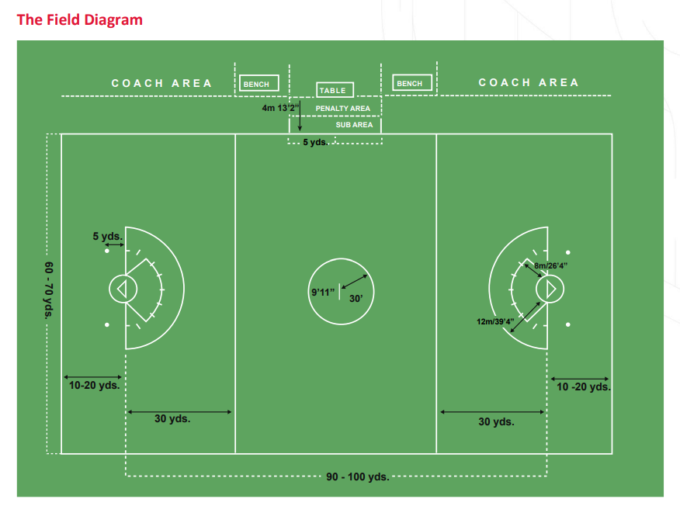

Slide 14
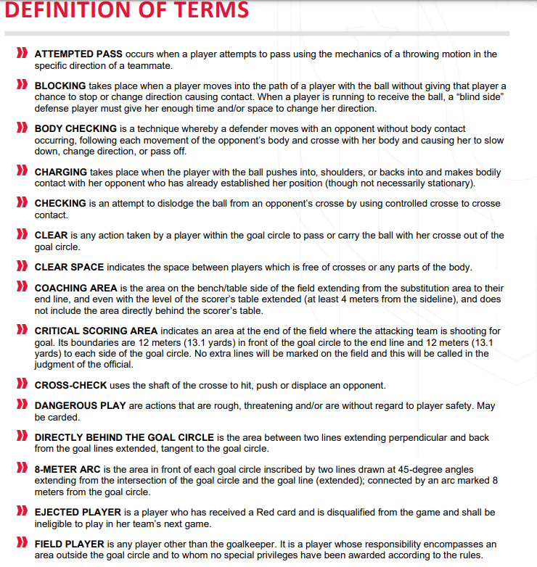

Slide 15
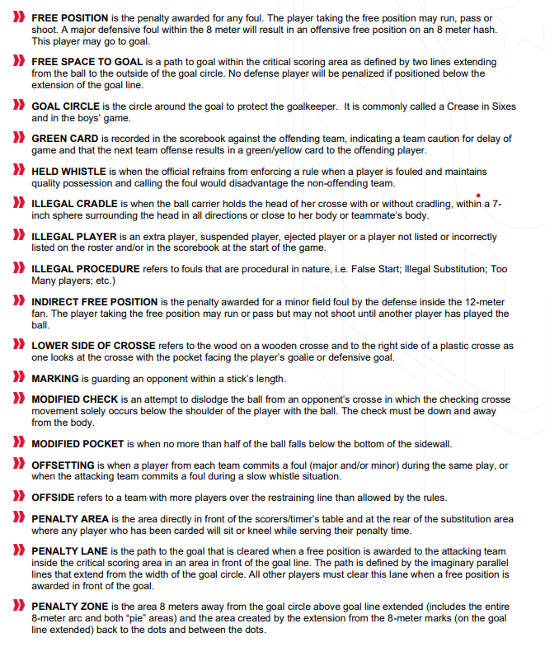

Slide 16
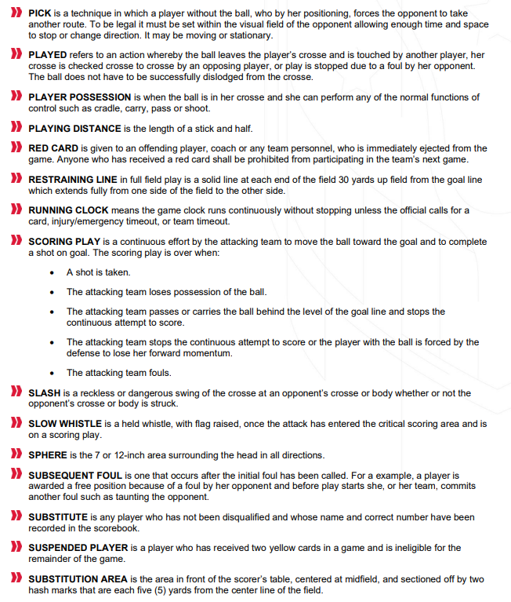

Slide 17
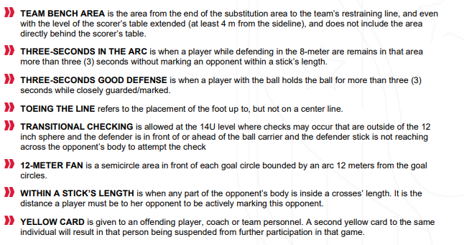

Slide 18
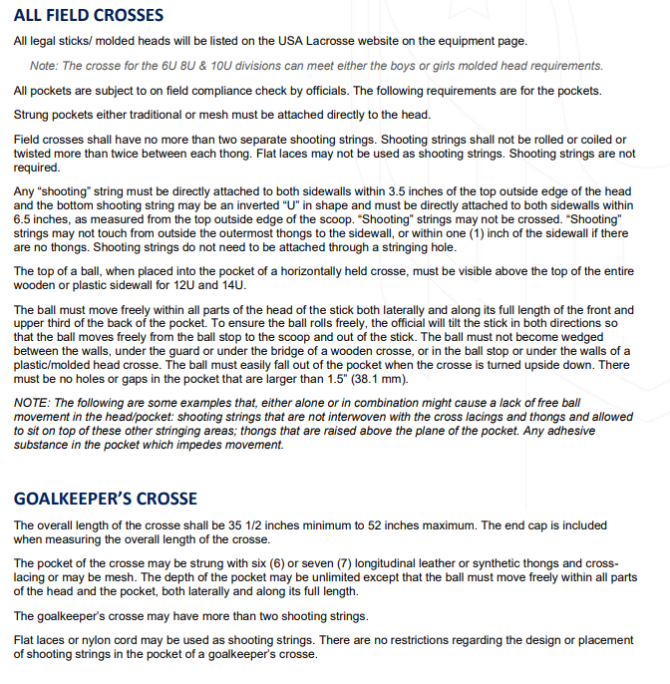

Slide 19
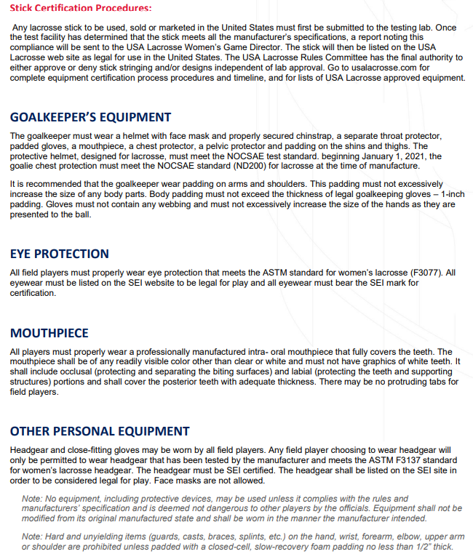

Slide 20
